Slide 1
File handling in C++
Ref: page 583-601 Robert Lafore

Slide 2
File opening for reading or writing
Include <fstream> for any file related operations
Step one
Create an object of ofstream for file writing
Or create an object of ifstream for file reading
Step two
Provide a file name either through constructor or member function
ofstream out(“file.txt”)’
OR
ofstream out;
out.open(“file.txt”);
File will be created, if not present already. Else its contents will be over-written

Slide 3
EOF
out.eof()
Returns true, if end of file is reached.

Slide 4
Types of File I/O
Formatted I/O
Character I/O
Binary Files

Slide 5
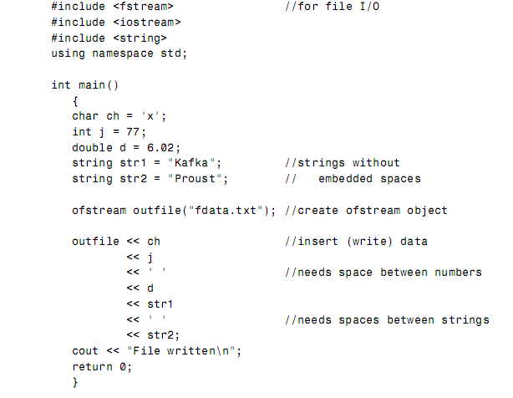
Formatted I/O – Writing data
Any type of data can be saved into the file

Slide 6
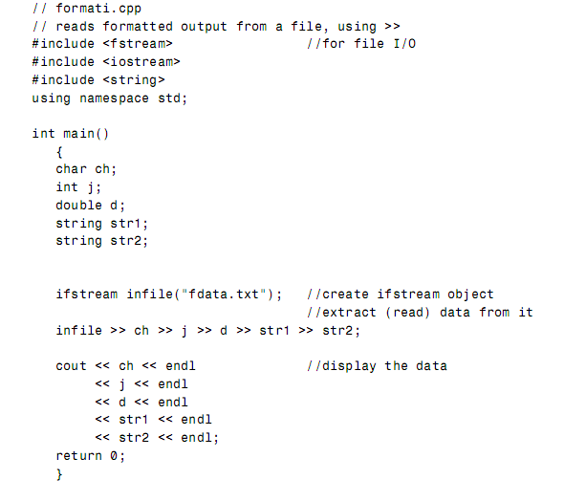
Reading data

Slide 7
Formatted I/O
Every thing that that is saved to a file with formatted i/o is a character, even the numeric data is also converted to characters
In formatted I/O, numbers are stored on disk as a series of characters. Thus 6.02, rather than being stored as a 4-byte type float or an 8-byte type double, is stored as the characters ‘6’, ‘.’, ‘0’, and ‘2’. This can be inefficient for numbers with many digits, but it’s appropriate in many situations and easy to implement.

Slide 8
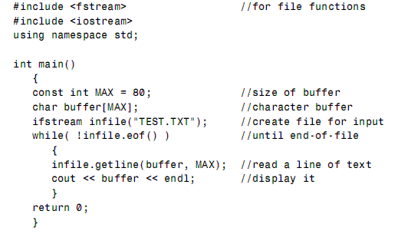
getline()
Reading strings can be problematic, if we read a multi word string using >> operator.
Use getline() function to input a string

Slide 9
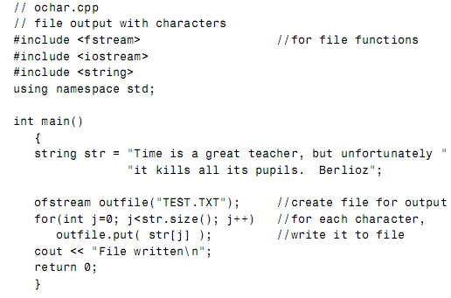
Character I/O
get() and put() are used to read and write character to and from a file

Slide 10
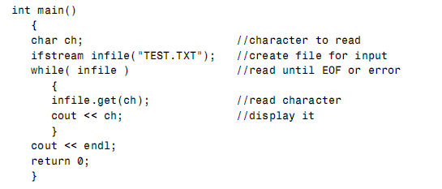
Reading character by character
get() skips the whitespace characters (space, tab, newline)

Slide 11
Binary I/O
writing few numbers to disk using formatted I/O is fine, but if large amount of numerical data is to be stored, then it’s more efficient to use binary I/O.
In Binary I/O, numbers are stored as they are in the computer’s RAM memory, rather than as strings of characters.
In binary I/O an int is stored in 4 bytes, whereas its text version might be “12345”, requiring 5 bytes. Similarly, a float is always stored in 4 bytes, while its formatted version might be “6.02314e13”, requiring 10 bytes.

Slide 12
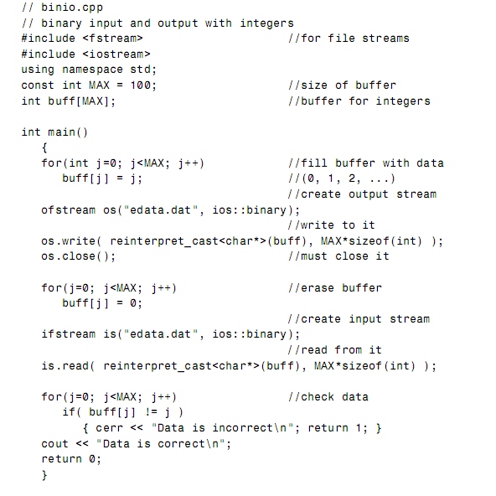
Writing an array to a file and reading it back in memory
(char*)
(char*)

Slide 13
Important
Closing a file
File is automatically closed, but it can also be explicitly closed with close() function.
Binary file
ios::binary is used as an argument to the open function. There are several other mode bits also (next slide)
explicit type casting
Both read and write only work with character arrays, so the array needs to be explicitly type casted, if its not char array

Slide 14
Binay I/O
Even objects of user defined classes can be written to file using binary i/o

Slide 15
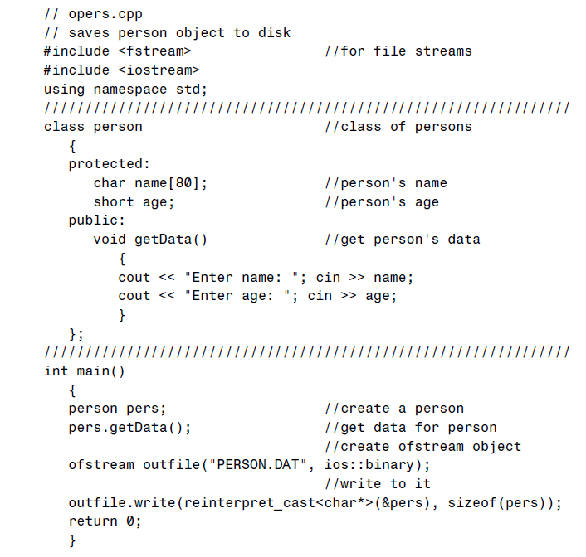

Slide 16
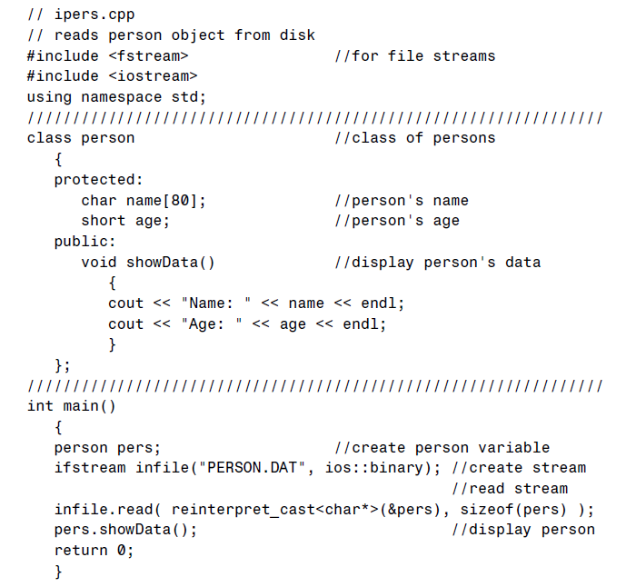
Reading back the object from the file

Slide 17
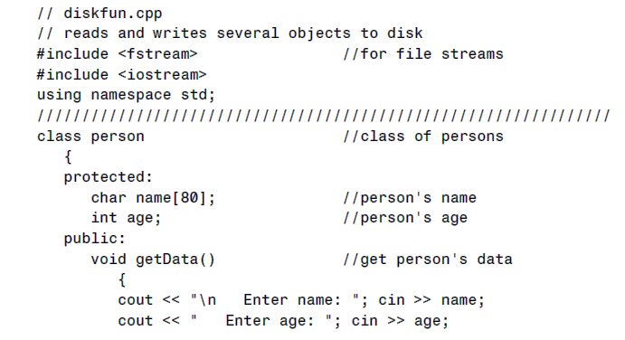
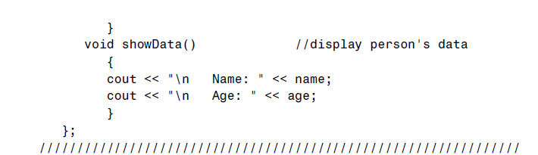
Reading and writing multiple objects to file

Slide 18
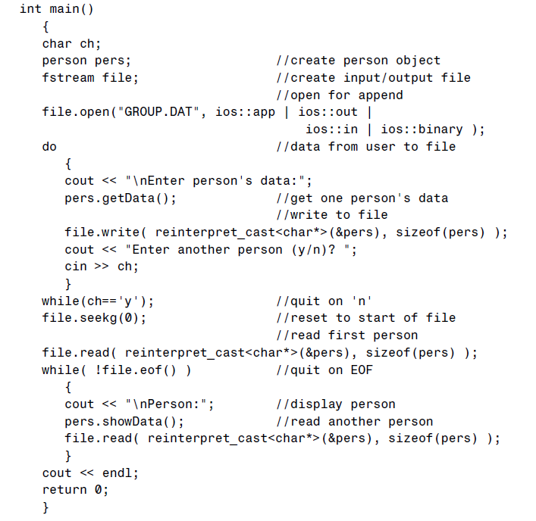

Slide 19
Mode Bits
Mode | Result
binary | Open file in binary (not text) mode
app | Start writing at the end of file (append)
in | Open for reading (default for ifstream)
out | Open for writing (default for ofstream)

Slide 20
Opening file for reading and writing
fstream file;
file.open(“sample.txt”, ios::in | ios::out);

Slide 21
Random File Access
seekg() / seekp()
Moves the cursor to specified location
tellg() / tellp()
Returns the position of cursor
seekg and tellg to be used with ifstream
seekp and tellp to be used with ofstresm
If object of fstream is used for reading/writing, then any of the above four functions can be used

Slide 22

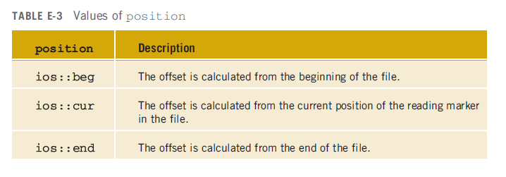

Slide 23
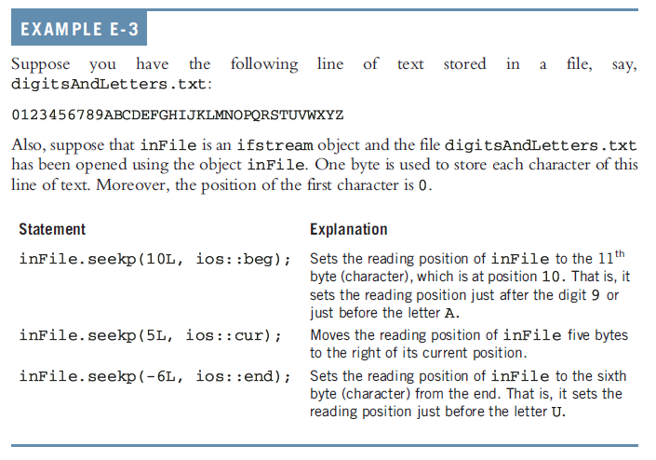

Slide 24
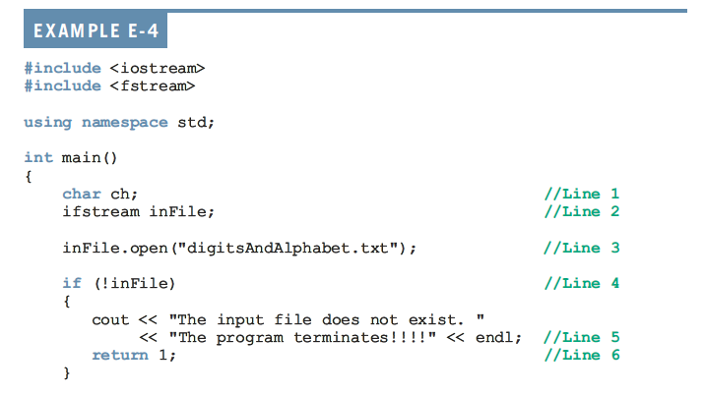

Slide 25
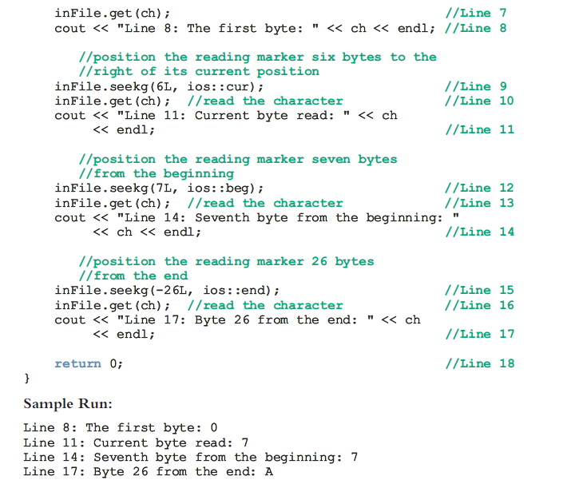

Slide 26
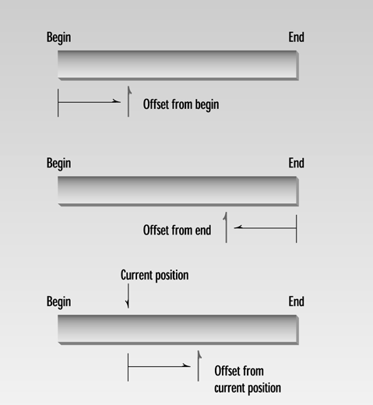

Slide 27
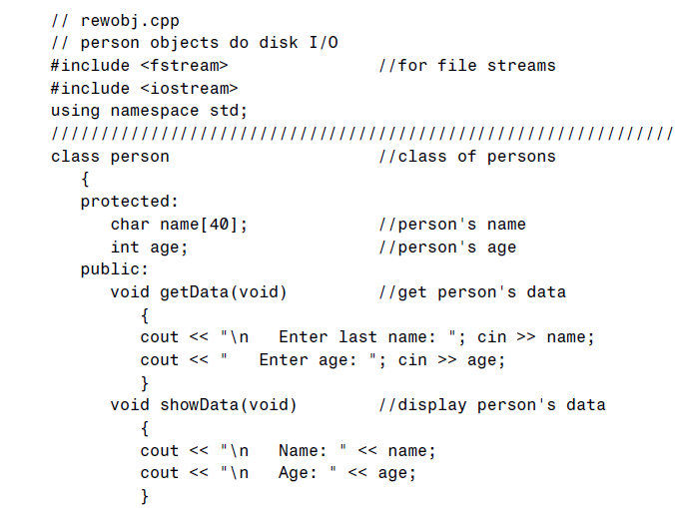
Objects That Read and Write Themselves
File reading and writing can also be implemented as a member function of the class

Slide 28
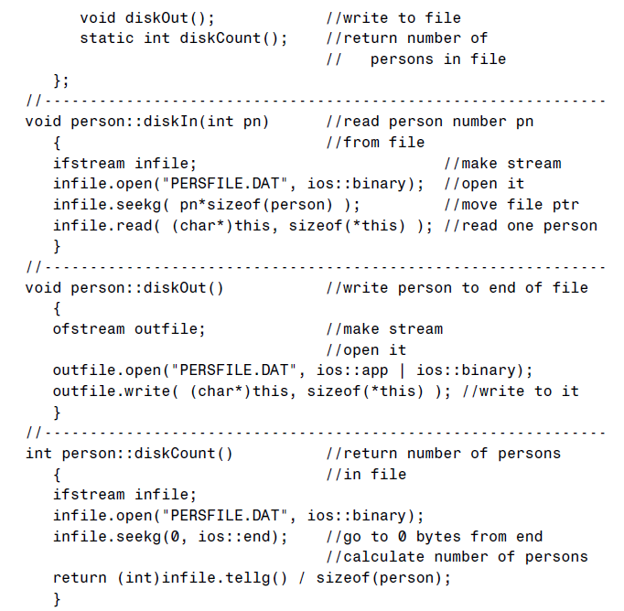

Slide 29
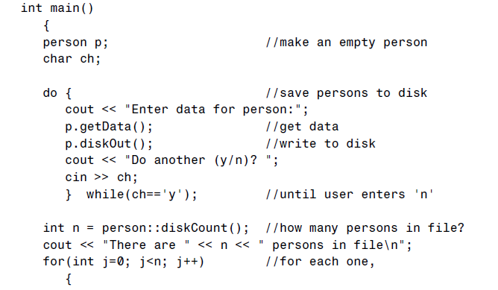
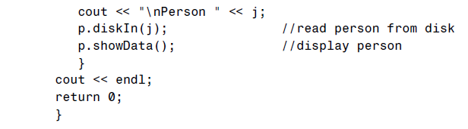

Slide 30
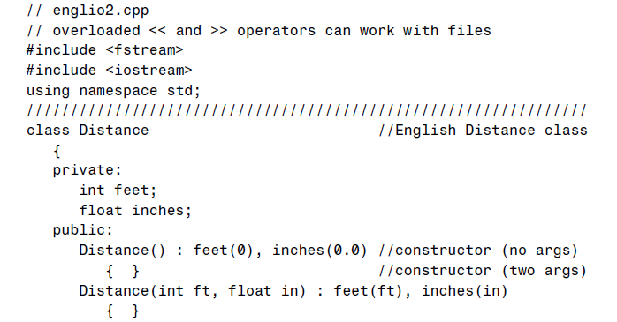

Overloading >> and << for File I/O and cout , cin

Slide 31
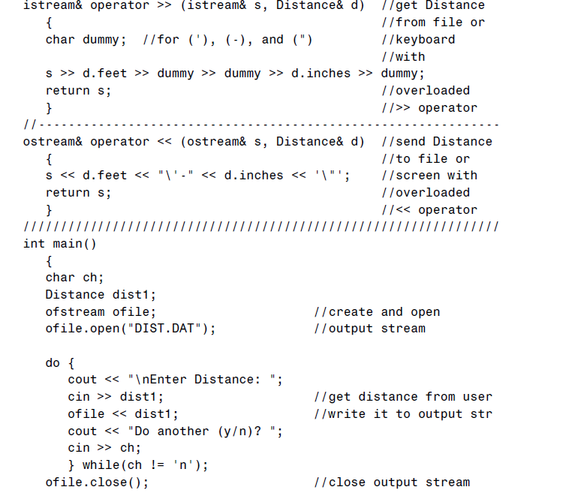

Slide 32
